Slide 1
Doing summary stats in excel
Wk 3

Slide 2
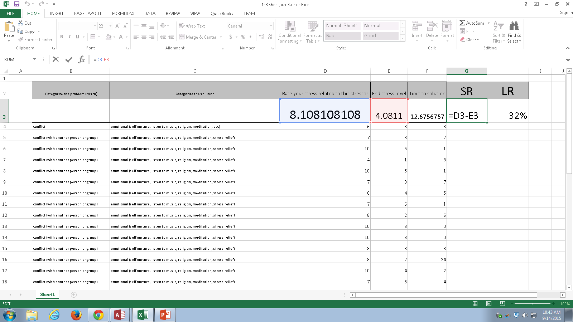

Slide 3
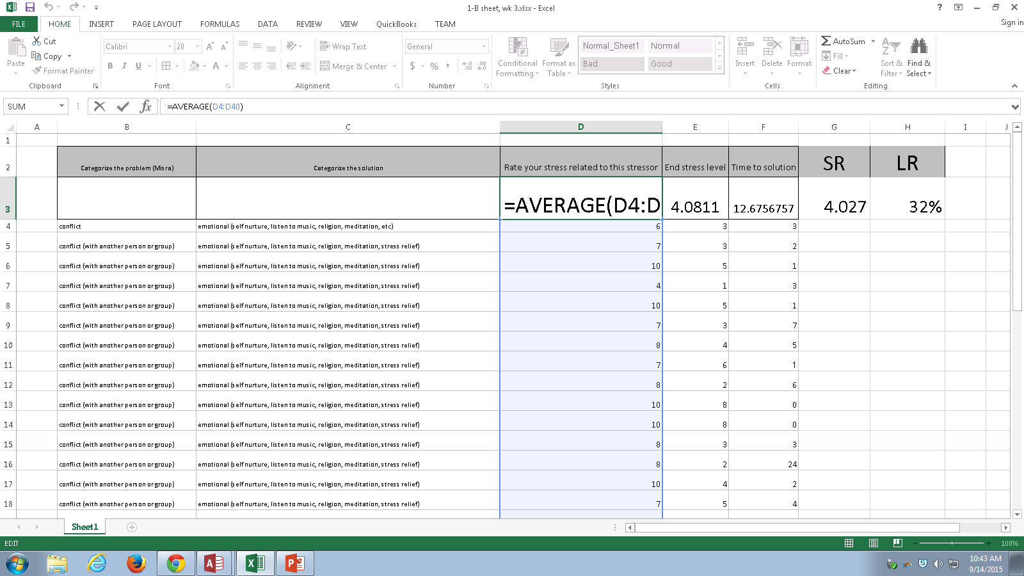

Slide 4
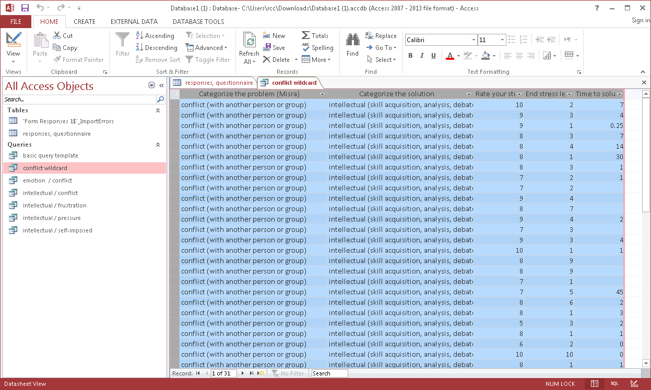
Copy /paste from Access query

Slide 5
